Slide 1
Javascript Libraries cleave.js Erhan
20.02.2021

Slide 2
Learn Objectives
cleave.js Nedir Ne ise yarar?
Demo

Slide 3
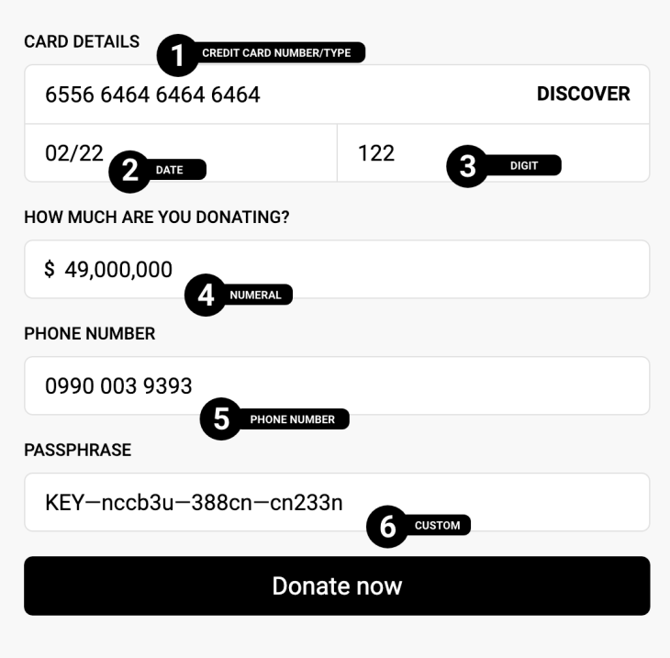
Format input text content when you are typing.
Cleave.js

Slide 4
Demo

Slide 5
Resources
Image 1:
creave.js cdn: https://nosir.github.io/cleave.js/dist/cleave.min.js
Demo Code:
https://jsfiddle.net/nosir/aLnhdf3z/

